Slide 1
Unified IT Solution for XYZ Health Solutions
Name: DL
Date: 2025

Slide 2
Executive Summary
Problem:
XYZ Health Solutions, a mid-sized healthcare provider facing challenges due to fragmented systems for managing patient records, appointment scheduling, and billing.
Key insights:
Recommended actions:

Slide 3
Introduction
Opportunity:
1.
2.
Approach:
1. Consolidate patient records, appointment scheduling, and billing across multiple clinic locations, while improving patient satisfaction by 20% and maintaining full HIPAA compliance.
2. Aligning CI/CD pipeline design and monitoring strategies with business goals, system reliability, and HIPAA compliance requirements.
Key questions/hypotheses:
1.
2.

Slide 4
Objectives
Develop a Project Charter to define the project's scope and objectives, analyzing the scenario to create a Stakeholder Register, and preparing a Stakeholder Engagement Plan
Drafting a BRD, developing a Use Case Diagram to model system interactions, and constructing an RTM that links each requirement to business objectives and testing criteria
Use key project artifacts, including the Work Breakdown Structure (WBS), Network Diagram, SWOT Analysis, Risk Register, and Risk Matrix, to manage tasks, timelines, and potential risks.
Developing a UML-compliant flowchart for the appointment scheduling process, a critical workflow within the XYZ Health Solutions IT System Integration initiative.
Clean and transform patient and appointment datasets in preparation for dashboard reporting.
Creating four key diagrams: data flow diagram (DFD), entity-relationship diagram (ERD), use case diagram, and sequence diagram, to visualize system architecture, processes, data relationships, and interactions.

Slide 5
Artifacts

Slide 6
Project Initiation and Stakeholder Engagement
Project Charter
Project Title | Name of the project | XYZ Health Solutions IT System Integration
Date | Date the charter is created | Q3, current year
Project Description | Brief overview of the project’s purpose and scope | This project aims to integrate patient records, appointment scheduling, and billing systems into a unified IT platform to enhance operational efficiency, improve data management, and support data-driven decision-making at XYZ Health Solutions. The initiative seeks to address current inefficiencies and inconsistencies in data management, ensuring compliance with healthcare regulations and boosting patient satisfaction.
Objectives | Specific, measurable goals of the project. | Integrate multiple IT systems into one unified platform for managing patient records, appointments, and billing. Maintain Health Insurance Portability and Accountability Act (HIPAA) compliance throughout the project lifecycle. Boost patient satisfaction by 10% within 12 months of system implementation. Improve operational efficiency by reducing manual processes and data errors. Provide real-time data access and reporting to support timely decision-making

Slide 7
Project Initiation and Stakeholder Engagement
Stakeholder Register
Interest Level | Stakeholder Name | Role | Influence Level
High | Dr. Maria Thompson | Executive Sponsor, CEO | High
High | Liam Carter | Project Lead, Project Manager, Systems Analyst | High
Medium | Priya Patel | IT Director | High
High | Dr. James Lee | Clinical Operations Manager | Medium
High | Aisha Khan | Patient Services Manager | Medium
High | Sofia Rivera | Data Analyst | Medium
High | Patients (End Users) | End Users | Low (individually), High (collectively)

Slide 8
Project Initiation and Stakeholder Engagement
Stakeholder Engagement Plan
Name | Current State | Desired State | Strategy
Dr. Maria Thompson | L | L | Maintain monthly strategic meetings to ensure ongoing support and alignment.
Liam Carter | L | L | Continue daily updates and check-ins to keep the project on track.
Priya Patel | N | S | Conduct technical workshops and provide regular security/compliance updates.
Dr. James Lee | S | L | Involve in workflow planning and provide tailored reports to increase engagement.
Aisha Khan | S | L | Incorporate patient feedback in feature design and involve in user testing.
Sofia Rivera | S | L | Leverage data insights for performance tracking and involve in data-driven decision-making.
Patients (End Users) | S | S | Communicate via intuitive channels (email/app) and gather regular feedback.

Slide 9
Requirements Gathering
Business Requirements Document (BRD)
1. Scope
The XYZ Health Solutions IT System Integration project aims to integrate disparate IT systems into a unified platform for managing patient records, scheduling, and billing. This integration will streamline operations, enhance data management, and improve the overall patient experience. The scope includes the development of a centralized database, real-time data access, and interactive dashboards for operational insights. The project will ensure HIPAA compliance and minimize system downtime during the integration process.
2. Objectives
Achieve HIPAA Compliance: Ensure that the integrated system meets all Health Insurance Portability and Accountability Act (HIPAA) requirements to protect patient data and maintain regulatory compliance.
Reduce Scheduling Errors: Aim to reduce scheduling errors by 20% within the first six months of system implementation by improving the accuracy and efficiency of the scheduling module.
Improve Patient Satisfaction: Boost patient satisfaction scores by 10% within 12 months of system go-live by enhancing the user experience and providing more efficient services.
Ensure Zero Downtime: Plan and execute the integration in a manner that ensures zero downtime, allowing for continuous operation and minimal disruption to daily activities.
Enhance Operational Efficiency: Streamline workflows and reduce manual processes to improve operational efficiency and data consistency across the organization.

Slide 10
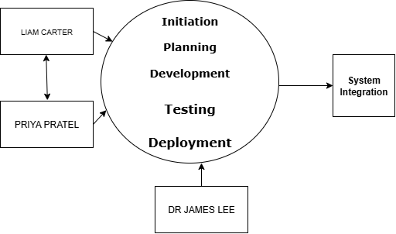
Requirements Gathering
Use Case Diagram and Detailed Flow Descriptions

Slide 11
Requirements Gathering
Requirements Traceability Matrix (RTM)
Entry | Instruction | Example
Project Name | Mention the project or program name for context. | XYZ Health Solutions IT System Integration
Requirement ID | Assign a unique identifier to each requirement using sequential numbering. | 001
Requirement Type | Specify if the requirement is Functional or Non-Functional. | Functional
Requirement Description | Provide a clear, concise description of the requirement. | The system shall integrate patient records, scheduling, and billing into a unified platform.
Source / Stakeholder | Identify where the requirement originated (e.g., stakeholder, workshop). | Liam Carter (Project Lead)
Business Objective / Goal | Describe the business need or strategic objective supported by the requirement. | Streamline operations and enhance patient experience.
Acceptance Criteria | Define the conditions under which the requirement will be accepted. | Successful integration of all systems with minimal downtime.
Linked Functional / Non-Functional Requirement | List related or dependent requirements by referencing their IDs. | 002 (Data Migration), 004 (HIPAA Compliance)
Owner | Identify the person or team responsible for fulfilling the requirement. | Priya Patel (IT Director)
Priority | Assign a priority level (e.g., High, Medium, Low). | High
Status | Track the progress (e.g., Not Started, In Progress, Blocked, Completed). | In Progress
Verification Method | Specify how the requirement will be verified (e.g., Testing, Inspection). | Testing
Related Risks | Identify risks associated with the requirement to assist in planning. | System integration challenges, data migration issues.
Comments / Notes | Capture additional information or ongoing discussions. | Regular updates and check-ins with the project team.

Slide 12
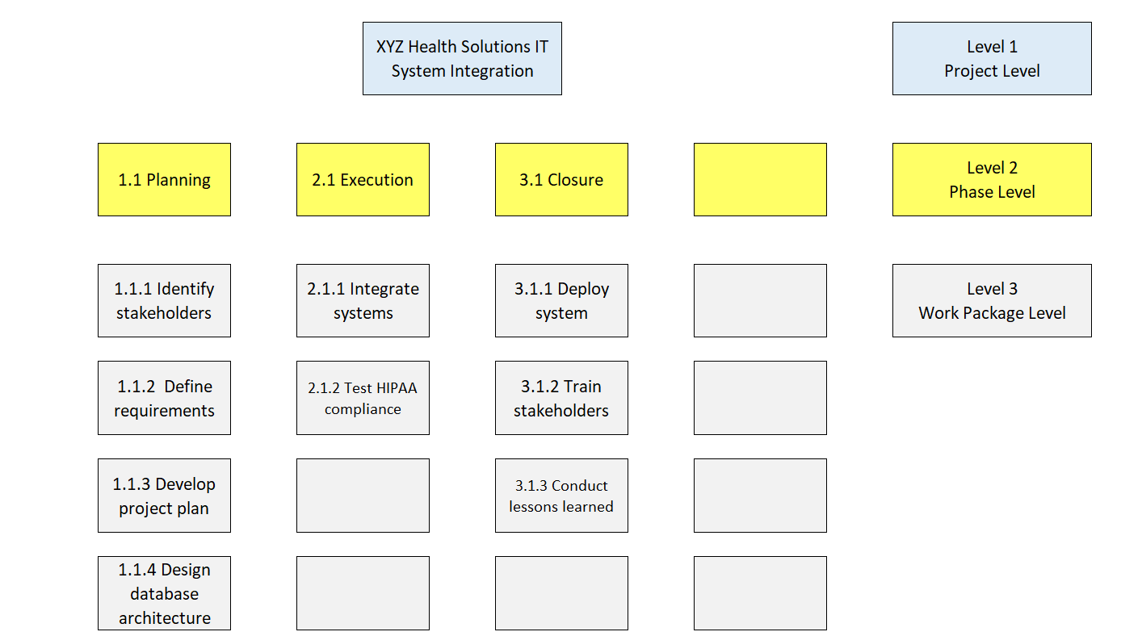
Project Planning and Risk Analysis
Work Breakdown Structure (WBS)

Slide 13
Project Planning and Risk Analysis
Network Diagram
Start v1.1.1 Identify stakeholders v1.1.2 Define requirements
v1.1.3 Develop project plan v1.1.4 Design database architecture
v1.2.1 Integrate systems v1.2.2 Test HIPAA compliance
v1.3.1 Deploy system
v1.3.2 Train stakeholders
v1.3.3 Conduct lessons learned
vEnd

Slide 14
Project Planning and Risk Analysis
SWOT Analysis
Strength (Cause) | Opportunity (Event)
Skilled IT Team: The organization has a competent IT team with the necessary technical expertise to handle the integration project. | Improved Patient Outcomes: A unified IT system can lead to better patient care and satisfaction by providing seamless access to records and reducing administrative errors.
Strong Stakeholder Support: There is robust support from key internal stakeholders, including the CEO and Project Manager, which is crucial for project success. | Enhanced Competitiveness: Implementing a state-of-the-art IT system can position XYZ Health Solutions as a leader in healthcare technology, attracting more patients and partnerships.
Existing IT Infrastructure: The availability of existing IT infrastructure can serve as a foundation, reducing the need for extensive new investments. | Data-Driven Decision Making: The integration of systems will allow for better data analytics, enabling more informed decision-making processes.
Weakness (Cause) | Threat (Event)
Legacy System Integration Challenges: The current fragmented systems may pose difficulties during the integration process, potentially leading to data inconsistencies or system downtime. | Regulatory Penalties: Non-compliance with regulations such as HIPAA can result in significant financial penalties and damage to the organization's reputation.
Budget Constraints: Limited budget may restrict the scope of the project or limit the ability to implement advanced solutions. | Resistance to Change: Staff and users may resist the new system, leading to delays and inefficiencies during the transition period.
 | Technological Obsolescence: Rapid advancements in technology may render the new system outdated sooner than expected, requiring frequent updates or replacements.

Slide 15
Project Planning and Risk Analysis
Risk Register
Project: Risk Register for XYZ Health Solutions IT System Integration Project Date: 2025
# | Cause | Event | Impact | Risk Owner | Category | Probability Risk Rating | Impact Risk Rating | Risk Score | Trigger | Response
R1 | Busy schedules | Missed deadlines | Timeline overrun | Liam Carter | Threat | 3 | 4 | 12 | Delayed responses to meeting requests | Send weekly reminders to stakeholders
R2 | Incompatible data formats | Data loss | Project delay | Priya Patel | Threat | 4 | 5 | 20 | Integration errors during testing | Develop and test backup integration plans
R3 | Weak governance |  |  |  | Threat | 2 | 5 | 10
R4 | User-friendly design |  |  |  | Opportunity | 5 | 4 | 20
Total Risk Score |  |  |  |  |  |  |  | 62

Slide 16
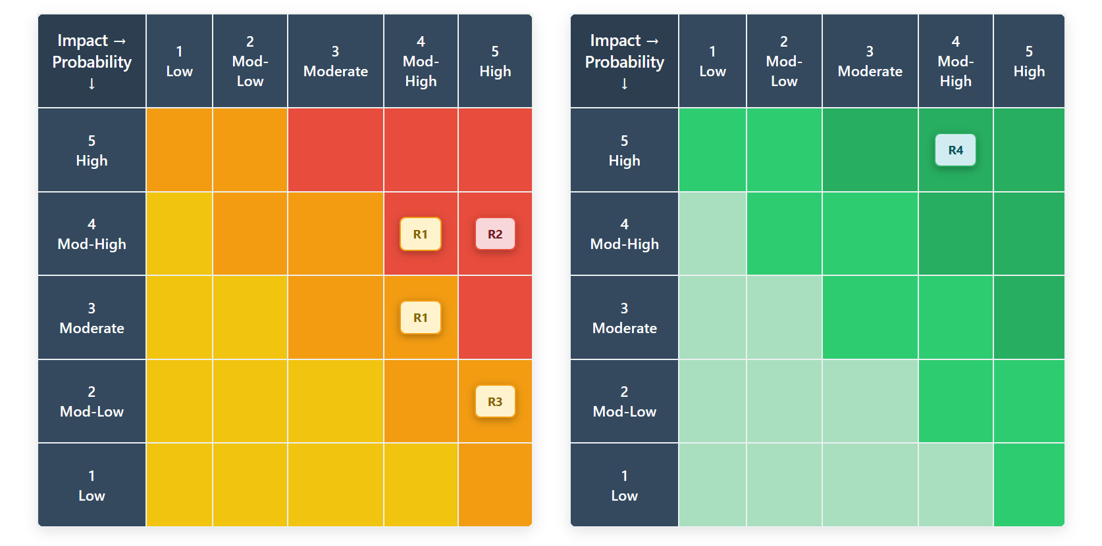
Project Planning and Risk Analysis
Risk Matrix

Slide 17
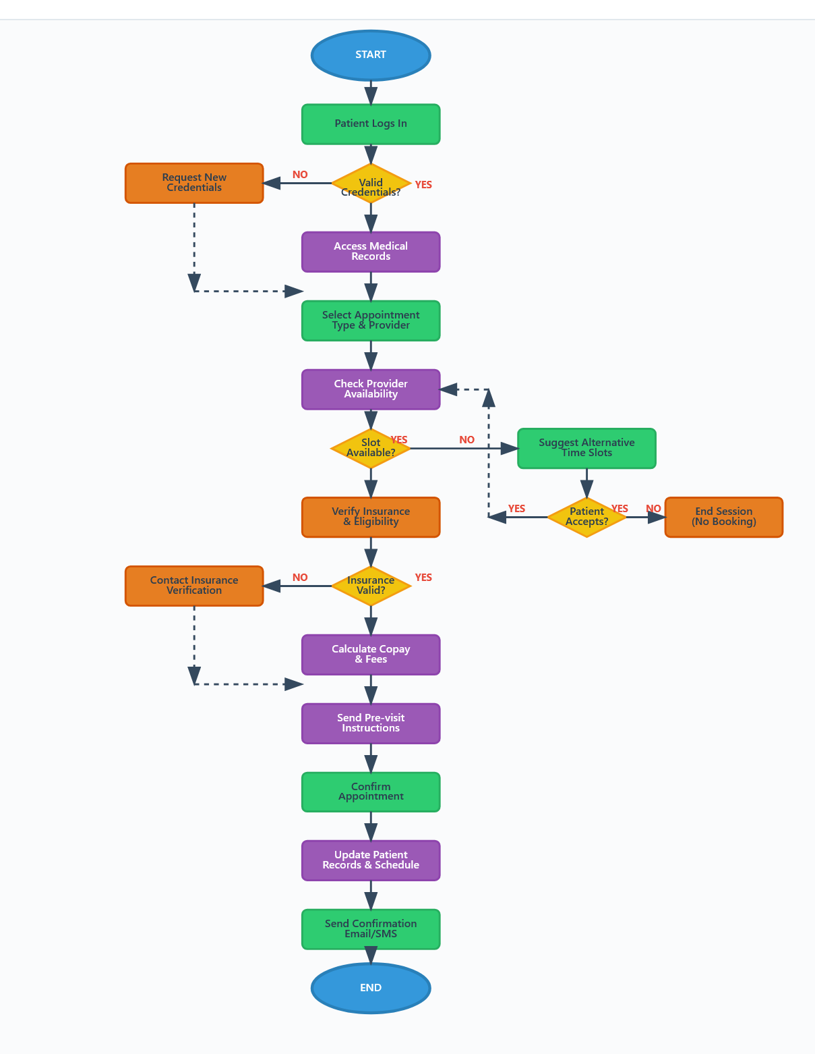
Process Modeling
Appointment Scheduling Process Flowchart

Slide 18
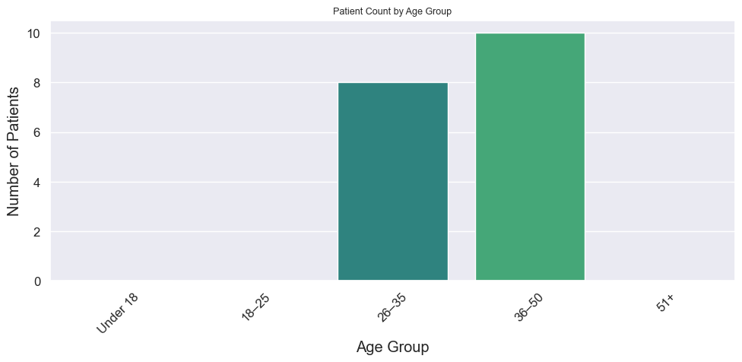
Visualizations
Patient Age Distribution

Slide 19
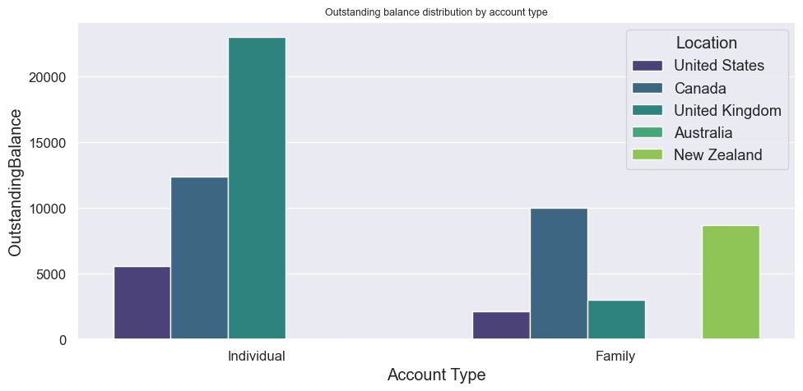
Visualizations
Outstanding Balance Distribution by Account Type

Slide 20
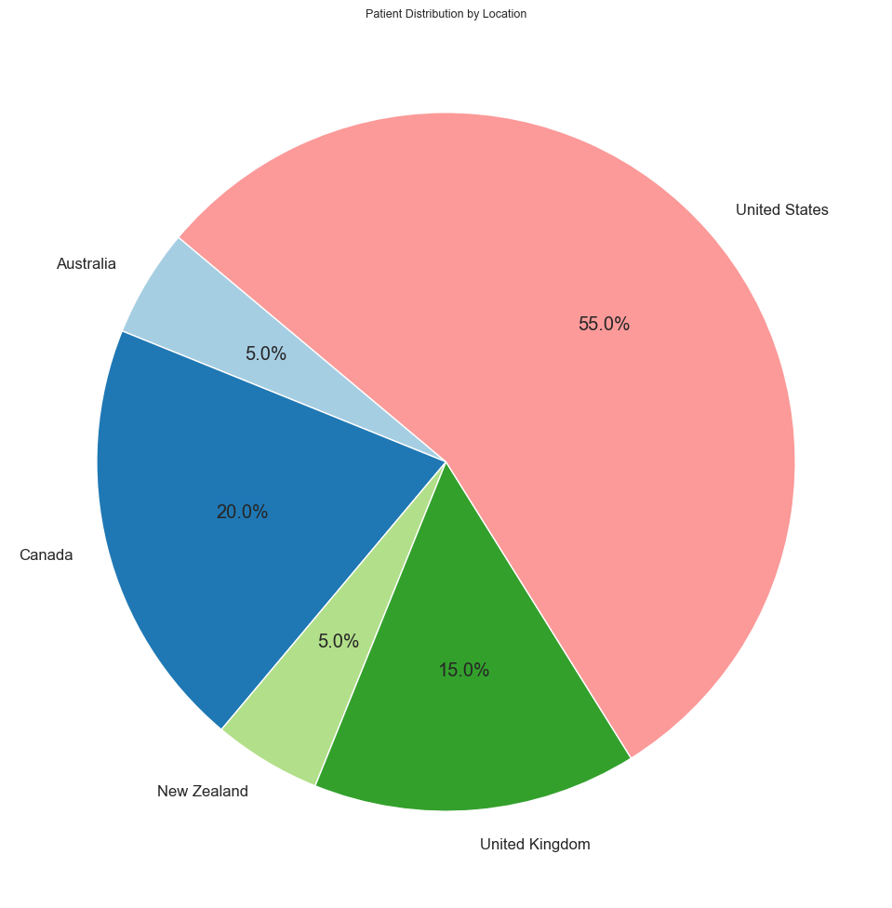
Visualizations
Location Representation

Slide 21
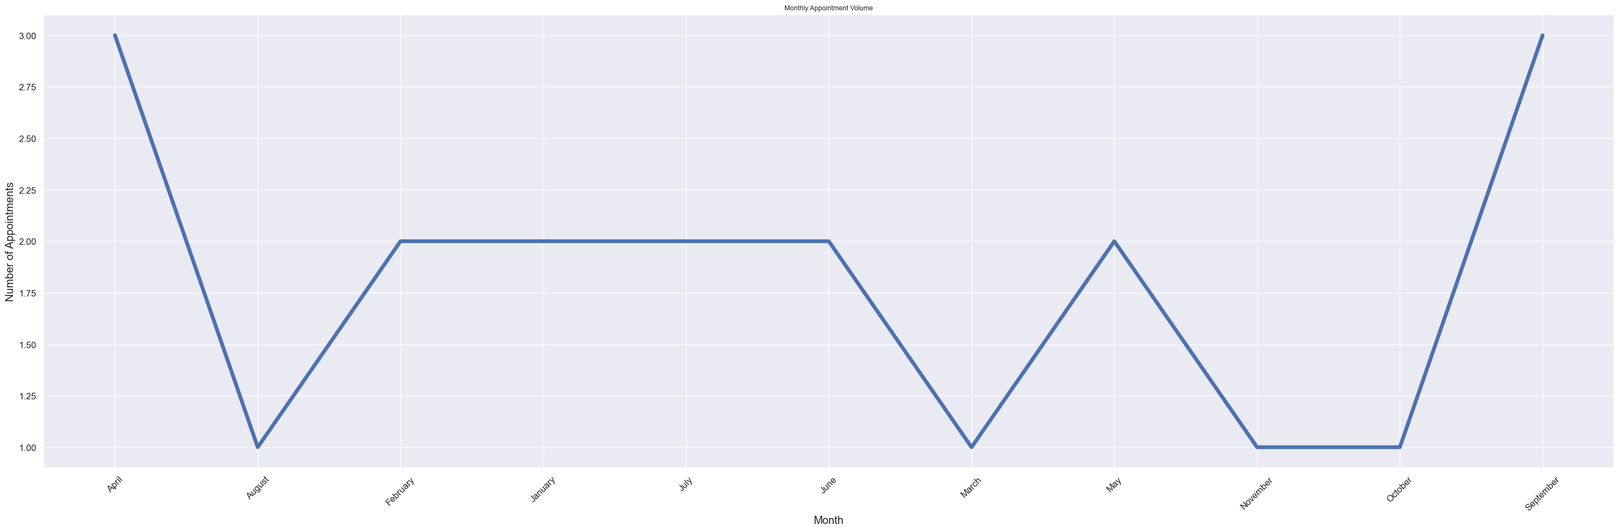
Visualizations
Monthly Appointment Volume

Slide 22
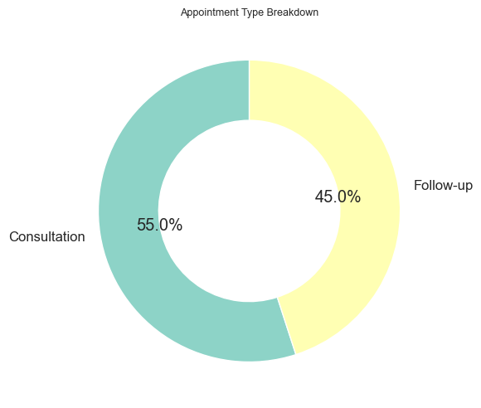
Basic Visualizations
Appointment Type Breakdown

Slide 23
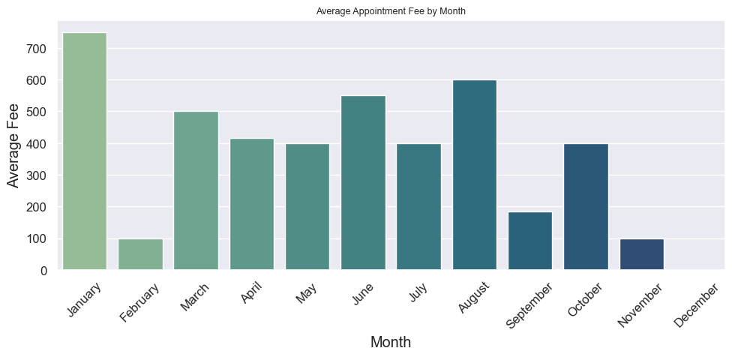
Basic Visualizations
Average Appointment Fee by Month

Slide 24
Dashboards
Branch Wise Average Age

Slide 25
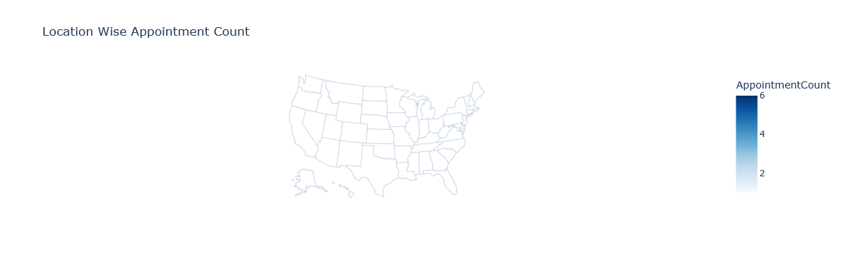
Dashboards
Location Wise Appointment Count

Slide 26
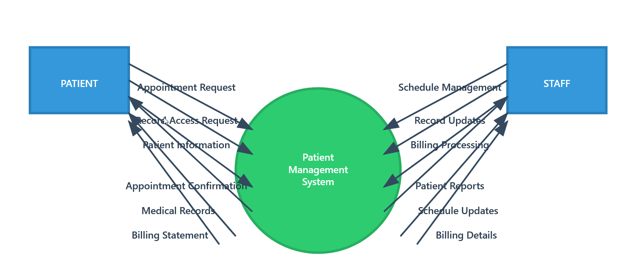
System Design
Data Flow Diagram (DFD)

Slide 27
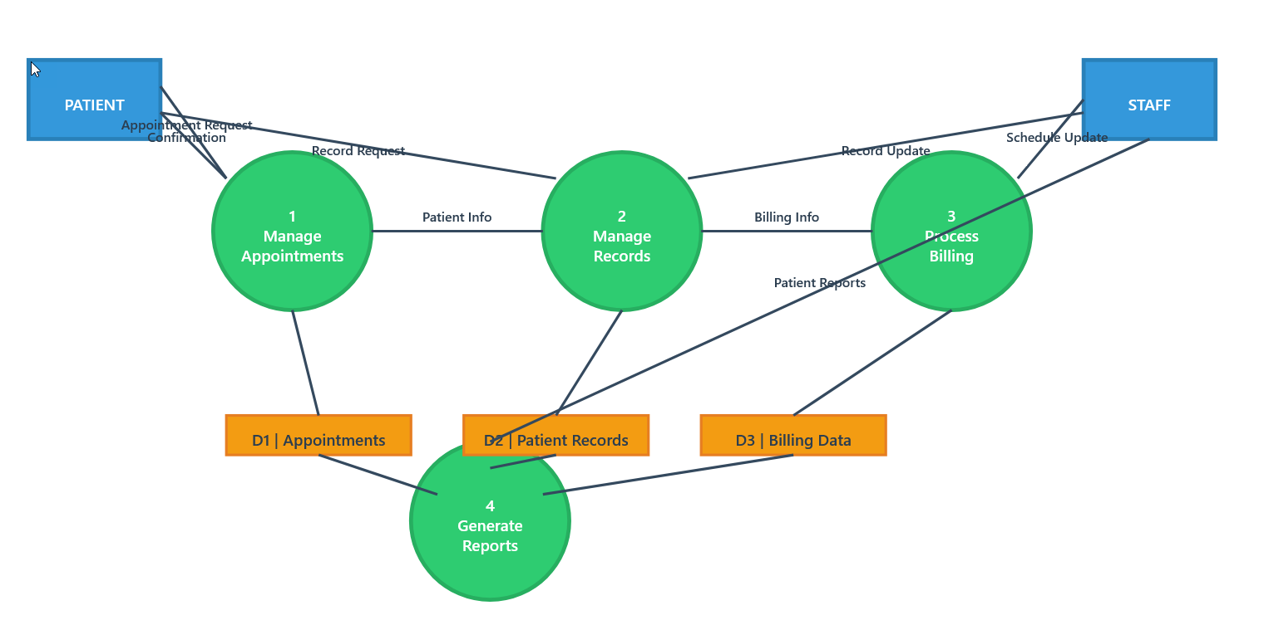
System Design
Level 1 DFD

Slide 28
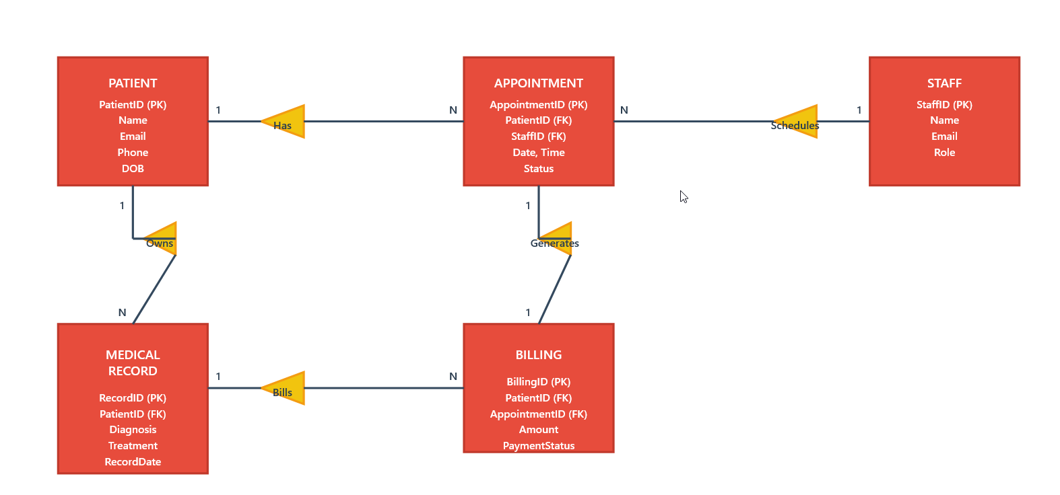
System Design
Entity-Relationship Diagram (ERD)

Slide 29
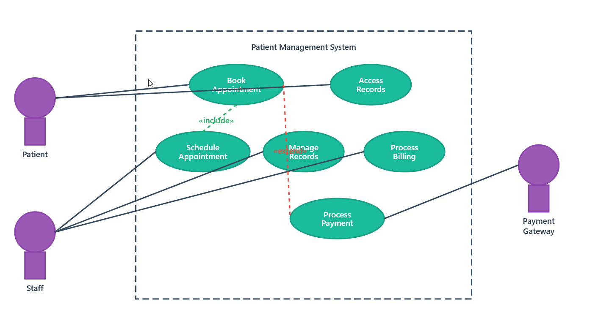
System Design
Use Case Diagram

Slide 30
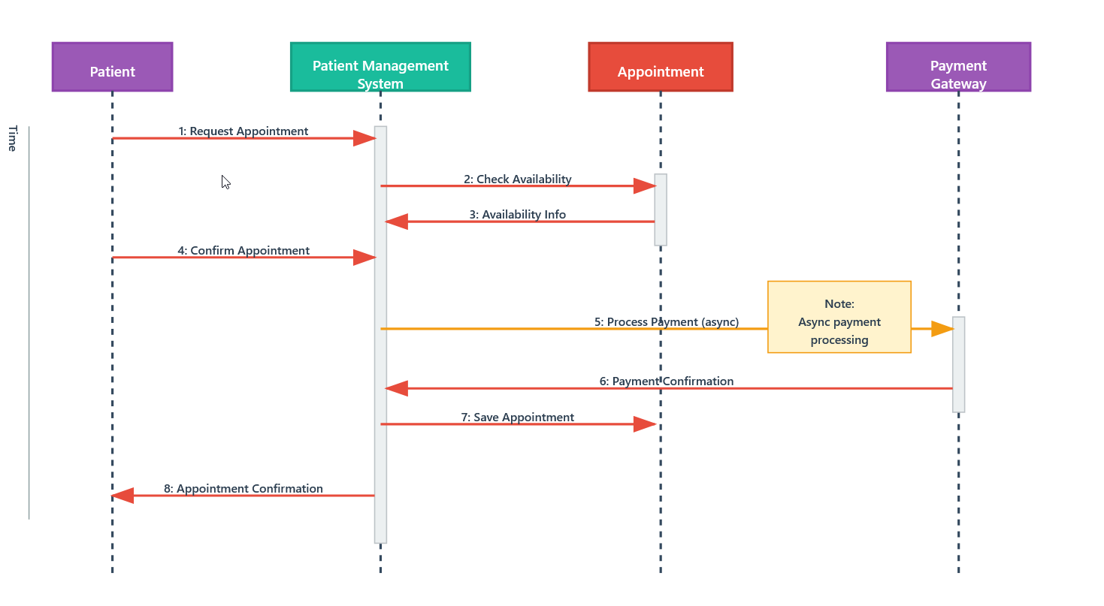
System Design
Sequence Diagram

Slide 31
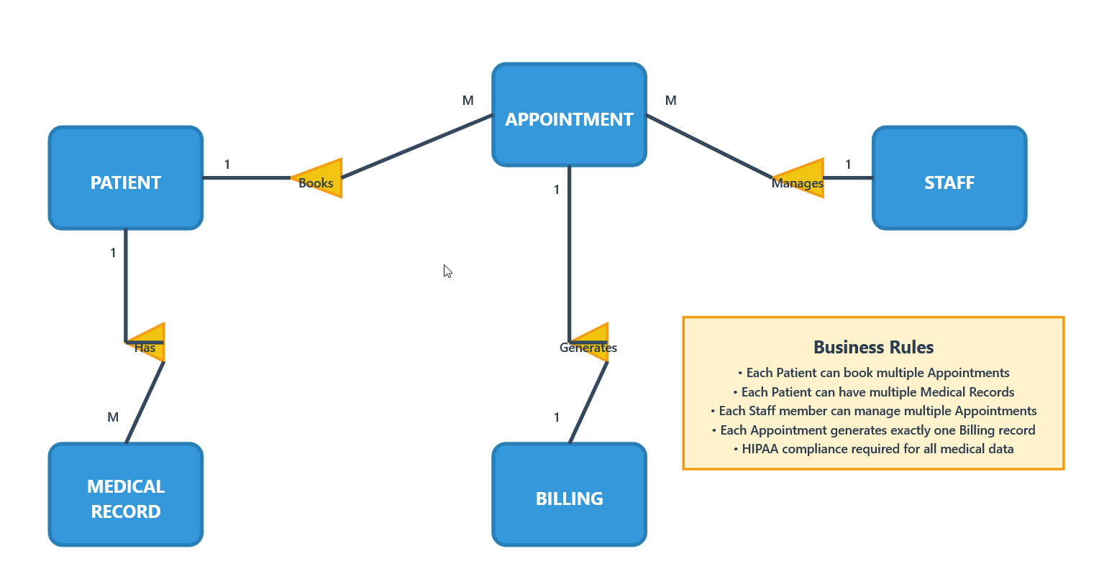
Database Design
Conceptual ERD

Slide 32
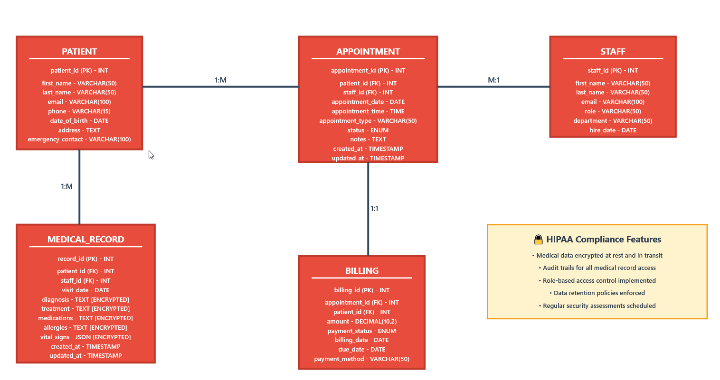
Database Design
Logical ERD

Slide 33
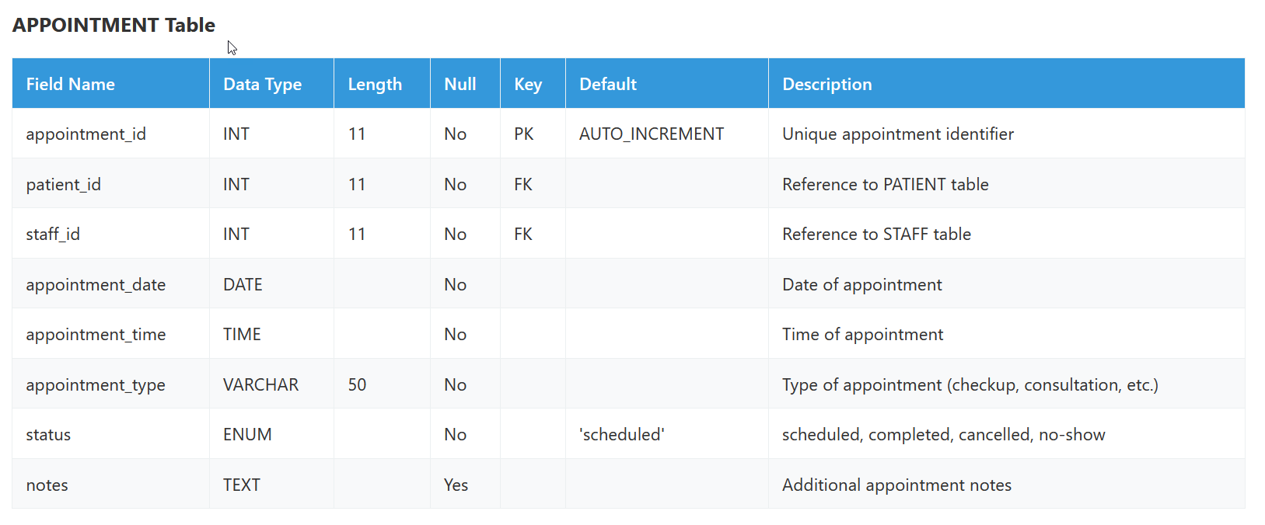
Database Design
Data Dictionary

Slide 34
Test Planning and Case Design Using TDD and BDD
Test Plan
Critical Gaps Identified:
HIPAA Compliance: Original plan had no explicit healthcare compliance testing
Security Vulnerabilities: Missing session timeout and data protection validation
Business Logic: No duplicate booking prevention testing
Information Disclosure: Original error messages could leak sensitive data

Slide 35
Test Planning and Case Design Using TDD and BDD
TDD and BDD Test Cases
Test Objective: Booking Restriction Logic Validation
Test Name: testBookingRestrictionAfterThreeFailedAttempts()
Objective:
Verify that the appointment booking system correctly implements the three-strike restriction mechanism by:
Scenario 1: Successful Appointment Booking
Feature: Patient Appointment Booking
As a registered patient I want to book medical appointments online So that I can schedule healthcare visits conveniently

Slide 36
CI/CD Workflow and Monitoring Plan
| **Stage** | **Type** | **Activities** | **Expected Outputs** | **Duration** |
|-----------|----------|----------------|---------------------|--------------|
| **1. Source Control** | Automated | Git commit triggers, branch protection rules, PR validation | Commit hash, branch status, PR approval | 2-5 min |
| **2. Build & Compile** | Automated | Code compilation, dependency resolution, artifact creation | Build artifacts, dependency report, build logs | 5-10 min |
| **3. Static Analysis** | Automated | Code quality checks, security scanning, HIPAA compliance validation | SonarQube report, security scan results, compliance checklist | 3-7 min |
| **4. Unit Testing** | Automated | TDD test execution, code coverage analysis, mock data validation | Test results, coverage report, performance metrics | 8-15 min |
| **5. Integration Testing** | Automated | API testing, database integration, third-party service validation | Integration test results, API response logs, DB connection status | 10-20 min |
| **6. Security Testing** | Automated | Vulnerability scanning, penetration testing, encryption validation | Security report, vulnerability list, encryption verification | 15-25 min |
| **7. HIPAA Compliance Review** | **Manual** | PHI handling validation, audit trail verification, consent management review | Compliance certificate, audit report, risk assessment | 30-60 min |
| **8. Staging Deployment** | Automated | Deploy to staging environment, smoke testing, environment validation | Deployment status, smoke test results, environment health | 5-10 min |
| **9. User Acceptance Testing** | **Manual** | BDD scenario validation, business stakeholder approval, usability testing | UAT sign-off, BDD test results, stakeholder approval | 2-4 hours |
| **10. Performance Testing** | Automated | Load testing, stress testing, appointment booking concurrency | Performance metrics, load test results, bottleneck analysis | 20-30 min |
| **11. Production Deployment** | **Manual** | Blue-green deployment, database migration, feature flag activation | Deployment confirmation, rollback plan, monitoring activation | 15-30 min |
| **12. Post-Deployment Validation** | Automated | Health checks, monitoring activation, alert configuration | System health status, monitoring dashboard, alert confirmation | 5-10 min |

Slide 37
CI/CD Workflow and Monitoring Plan
Monitoring and maintenance strategy
#### **Metric 1: Appointment Booking Success Rate**
- **Description:** Percentage of successful appointment bookings vs. total attempts
- **Target:** ≥ 99.5%
- **Data Source:** Application logs, database transactions
- **Business Impact:** Direct patient experience indicator
#### **Metric 2: Authentication Failure Rate**
- **Description:** Failed login attempts per PatientID (linked to TC-002, TC-005)
- **Target:** < 2% of total attempts
- **Data Source:** Authentication service logs
- **Business Impact:** Security and user experience
#### **Metric 3: System Response Time**
- **Description:** Average API response time for appointment booking
- **Target:** < 2 seconds for 95th percentile
- **Data Source:** APM tools, load balancer logs
- **Business Impact:** Patient satisfaction and system performance
#### **Metric 4: HIPAA Audit Trail Completeness**
- **Description:** Percentage of patient data access events with complete audit logs
- **Target:** 100%
- **Data Source:** Audit logging system
- **Business Impact:** Regulatory compliance and legal protection

Slide 38
Findings and Recommendations

Slide 39
Key Findings
1.
2.
3.

Slide 40
Key Recommendations
1.
2.
3.
4.

Slide 41
Conclusion
1.
2.
3.
4.

Slide 42
Appendix

